Slide 1

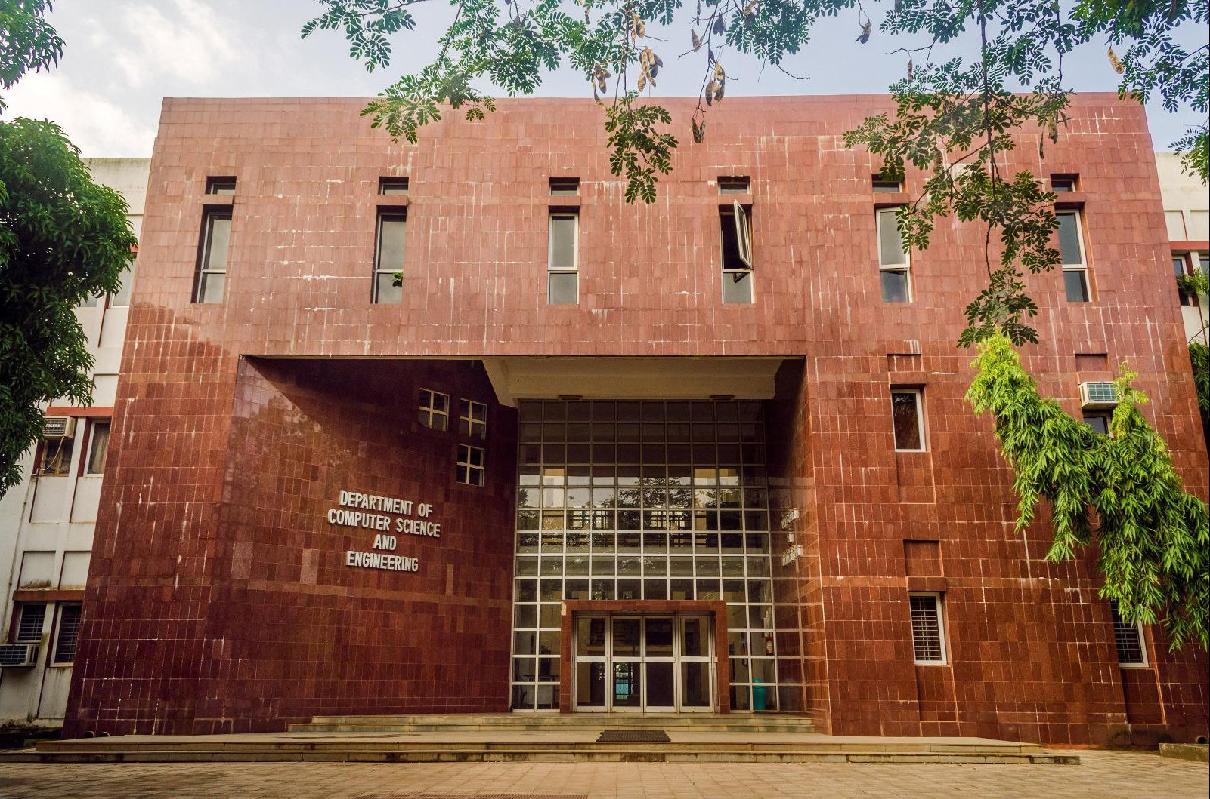
Industrial Training
Presentation
Department of CSE, IIT Kharagpur
Name: Satyam Rahangdale
Roll Number: 22CH10062
Department: Chemical Engineering
Internship Role: Full Stack Developer
Project Title: ASR-FairBench
Organization: Department of CSE, IIT Kharagpur
Supervisor: Prof. Animesh Mukherjee
Date of Commencement: May 3, 2025
Date of Completion: June 28, 2025
Working Days Attended: 57 days

Slide 2
Overview
Objective: To design, develop, and deploy an end-to-end web platform for automated ASR model performance evaluation and fairness assessment.
Key Expectations:
Develop full-stack web applications
Learn industry-standard development & deployment practices
Requirements:
Experience with at least one modern frontend framework: React.js, Vue.js, or Angular.js
Understanding of responsive and adaptive design
Experiance in backend development using Node.js or Python, or similar
Familiarity with containerization (Docker) and deployment pipelines (CI/CD)
Strong proficiency in JavaScript (ES6+), HTML5, and CSS3
Experience with RESTful APIs and/or GraphQL
Knowledge of version control using Git
Understanding of database systems: relational (PostgreSQL, MySQL) and/or NoSQL (MongoDB, Redis)

Slide 3

ASR FairBench
Measuring and Benchmarking Equity Across Speech Recognition Systems
Co-developed ASR-FairBench, a real-time benchmarking platform evaluating fairness and accuracy in Automatic Speech Recognition models
Proposed a novel metric —Fairness-Adjusted ASR Score (FAAS) —combining WER and statistical fairness across demographic groups
ASR-FairBench features interactive visualizations (box plots, histograms) and a real-time leaderboard for seamless comparison of Automatic Speech Recognition models
Optimized the pipeline to evaluate results within 30 minutes on high-end GPUs, enabling rapid feedback for researchers and developers
Hosted on Hugging Face with React frontend and Flask backend served via Docker, offering users web interface to benchmark ASR models
Public Url: https://huggingface.co/spaces/satyamr196/ASR-FairBench

Slide 4
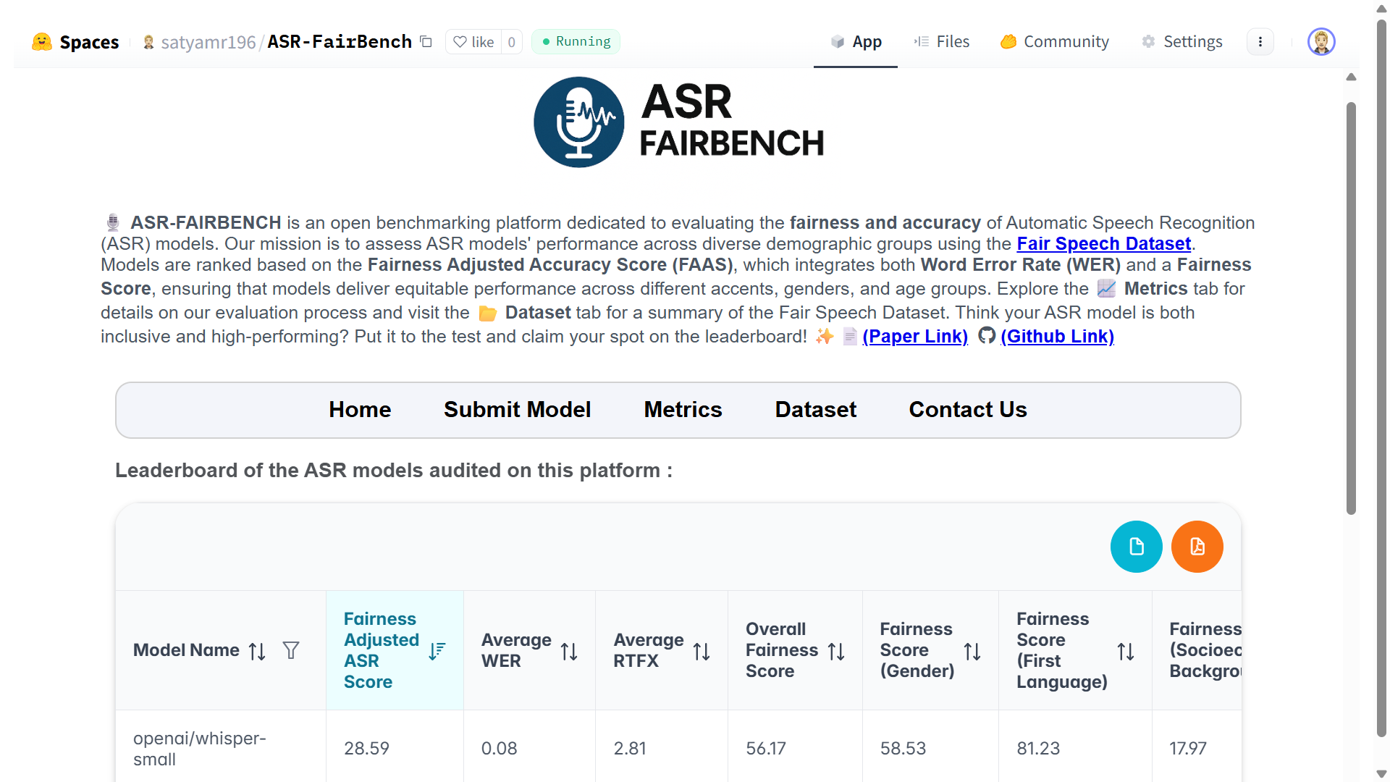
Notes:
Home page of ASR – FairBench Leaderboard
While describing Table → Introduce FAAS, → WE have a paper on this . This paper and this platfrom are kind of linked together.
Other columns WER, RTFx → This is especially helpful in choosing ASR model
Two circular buttons, → Export table to PDF or CSV

Slide 5
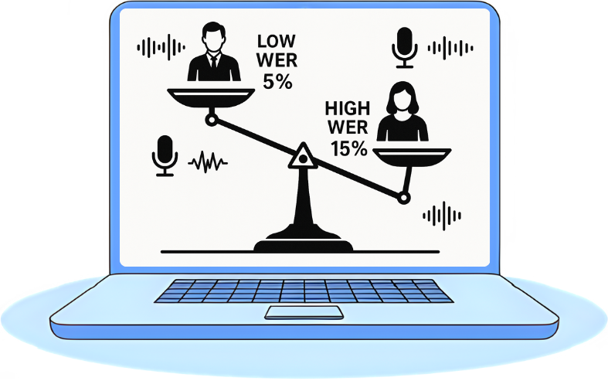
Motivation
Transcripts make videos accessible and comprehensible.
Fair and inclusive ASRs ensures equal participation and understanding for all.
Limitations of traditional benchmarks focused solely on aggregate accuracy (WER).
Need for a fairness-aware evaluation framework.
Choosing an ASR model that is both accurate and fair is critical for real-world applications like voice assistants, messenger apps, chatbots, and transcription systems.
We developed ASR FairBench, an open benchmarking platform dedicated to evaluating Automatic Speech Recognition (ASR) models based on both accuracy and fairness.

Slide 6
Technical Stack And Tools
Frontend Technologies:
React.js
React Router(Routing in SPAs)
Plotly.js
Recharts
PrimeReact (UI library)
React-KaTex(Math Typesetting for web)
Styled Components (CSS in JS)
Axios
jsPDF
Backend Technologies:
Python
Flask
JiWER
Numpy & Pandas
Mailjet
Pydub & PySoundFile
Data Storage & Management:
Hugging Face Hub
Hugging Face API
Development Tools:
Hugging Face Transformers(for inferencing)
Hugging Face Space(for deployment)
Git & Git-LFS for version control
VS-Code IDE
Docker
Notes:
Data Storage and Management
Hugging Face Hub – for hosting and versioning datasets and model outputs
Hugging Face API – for programmatic access to stored assets and integration with the application

Slide 7

Workflow overview
4
Publish Summary
Share the findings on the ASR- FairBench dashboard for transparency.
3
Analyze Results
Interpret the audit results, including FAAS and WER metrics.
2
Run Audit
Evaluate the model's fairness using the ASR-FairBench framework.
1
Select Model
Choose an ASR model from the Hugging Face Model Hub.

Slide 8
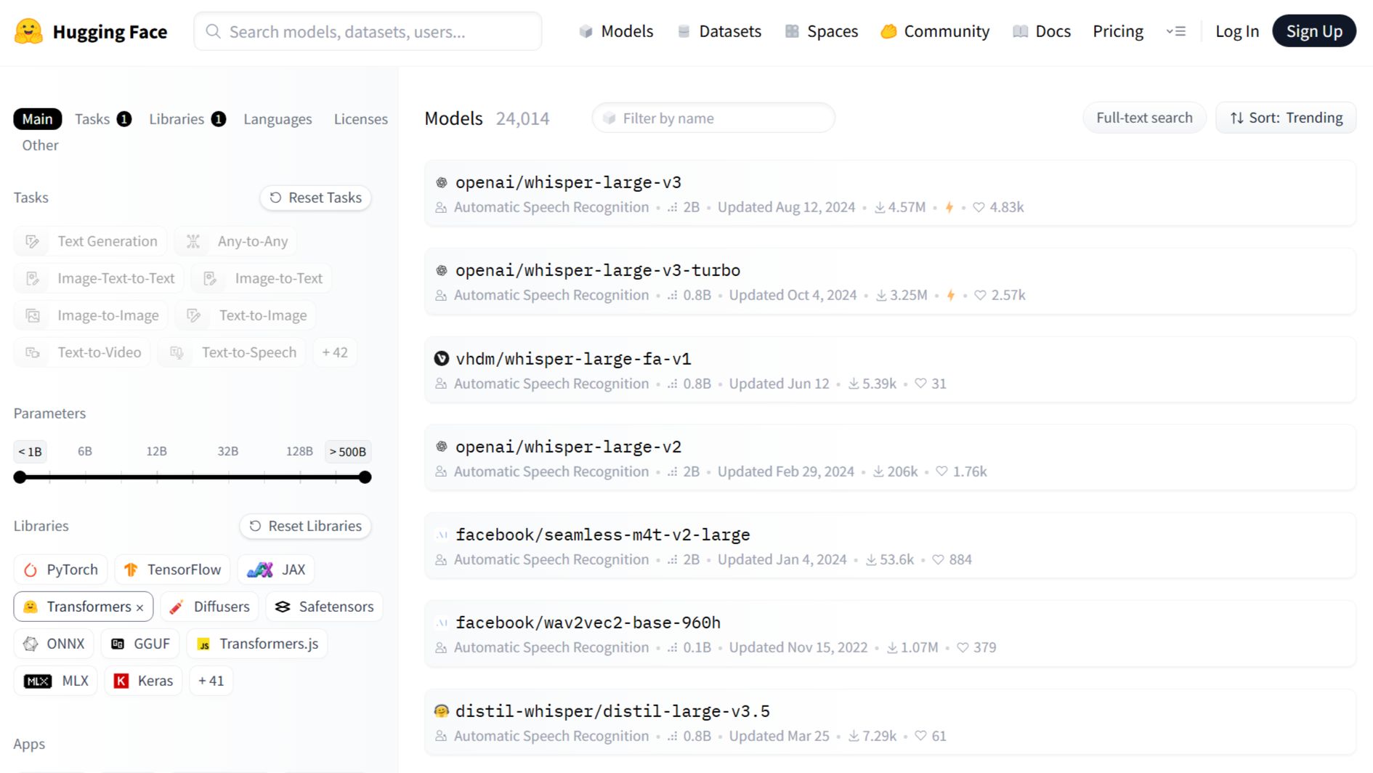
1. Select Model

Slide 9
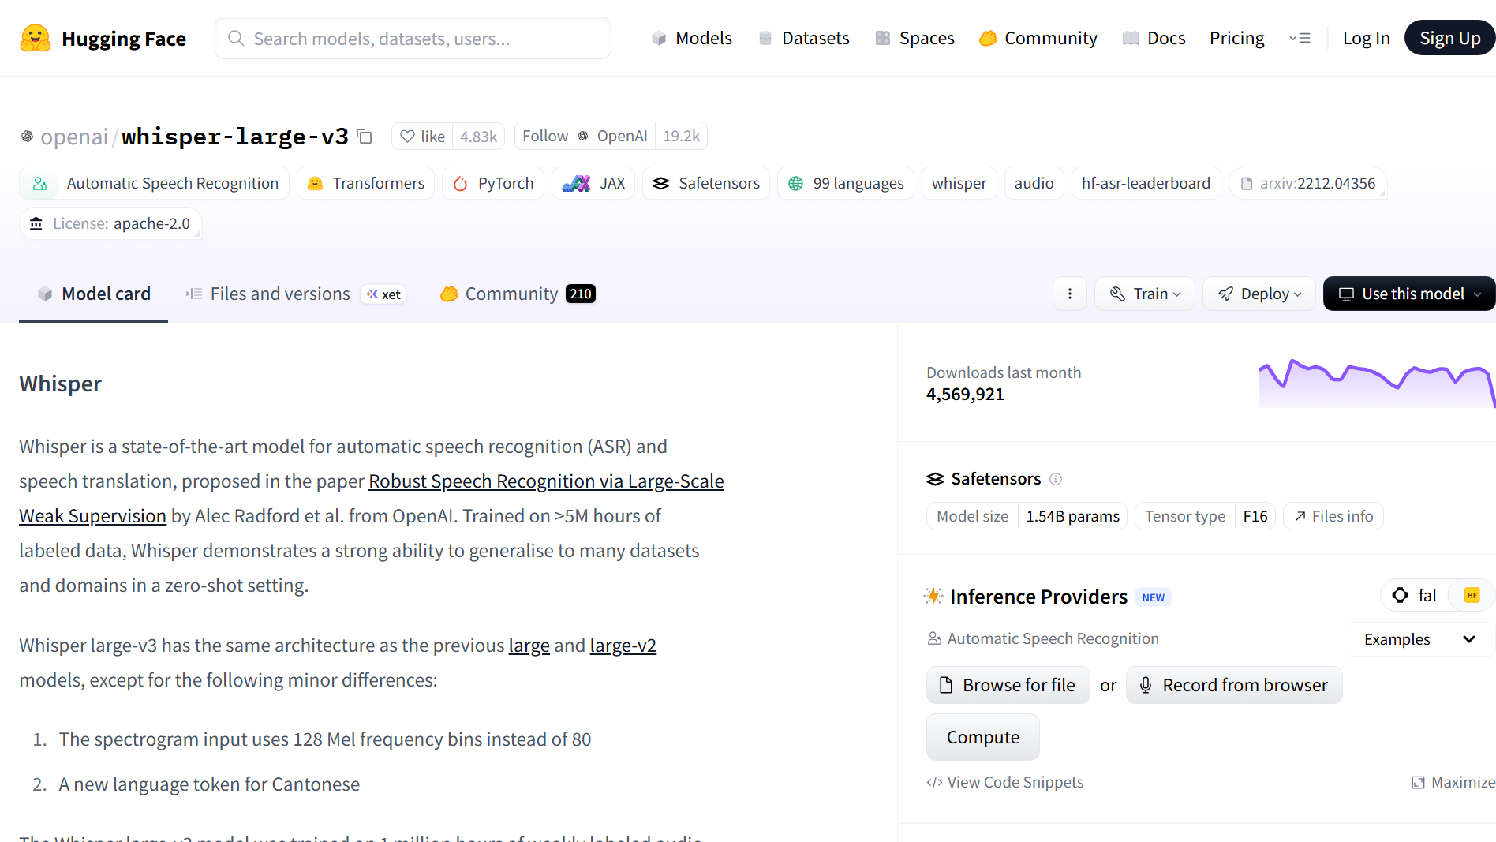
1. Select Model

Slide 10
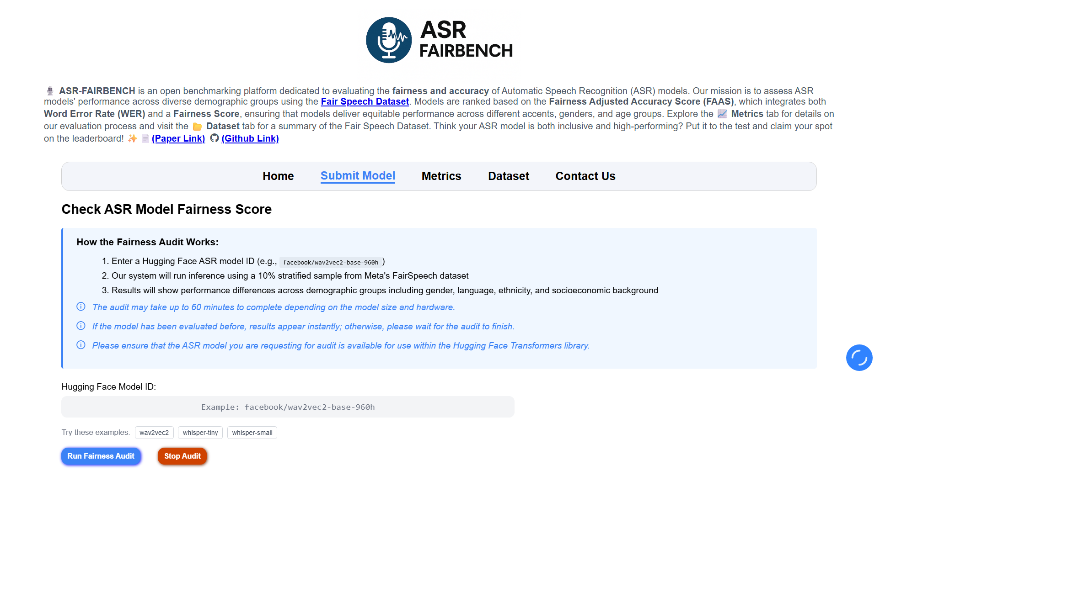
2. Run Audit

Slide 11
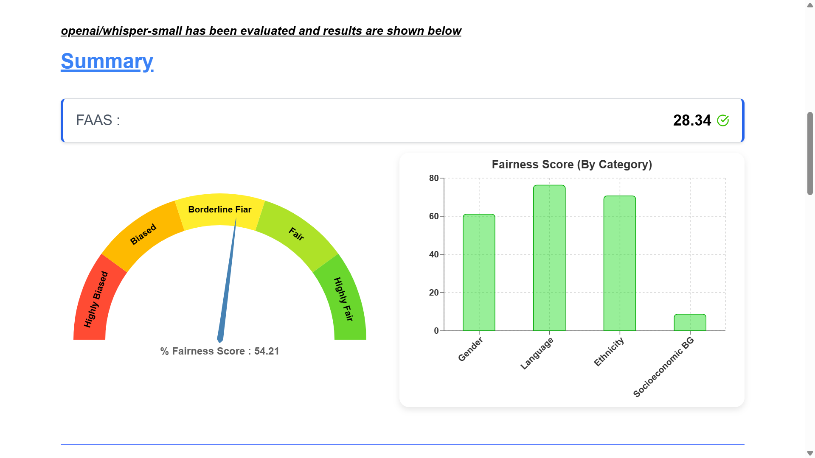
3. Analyze Results

Slide 12
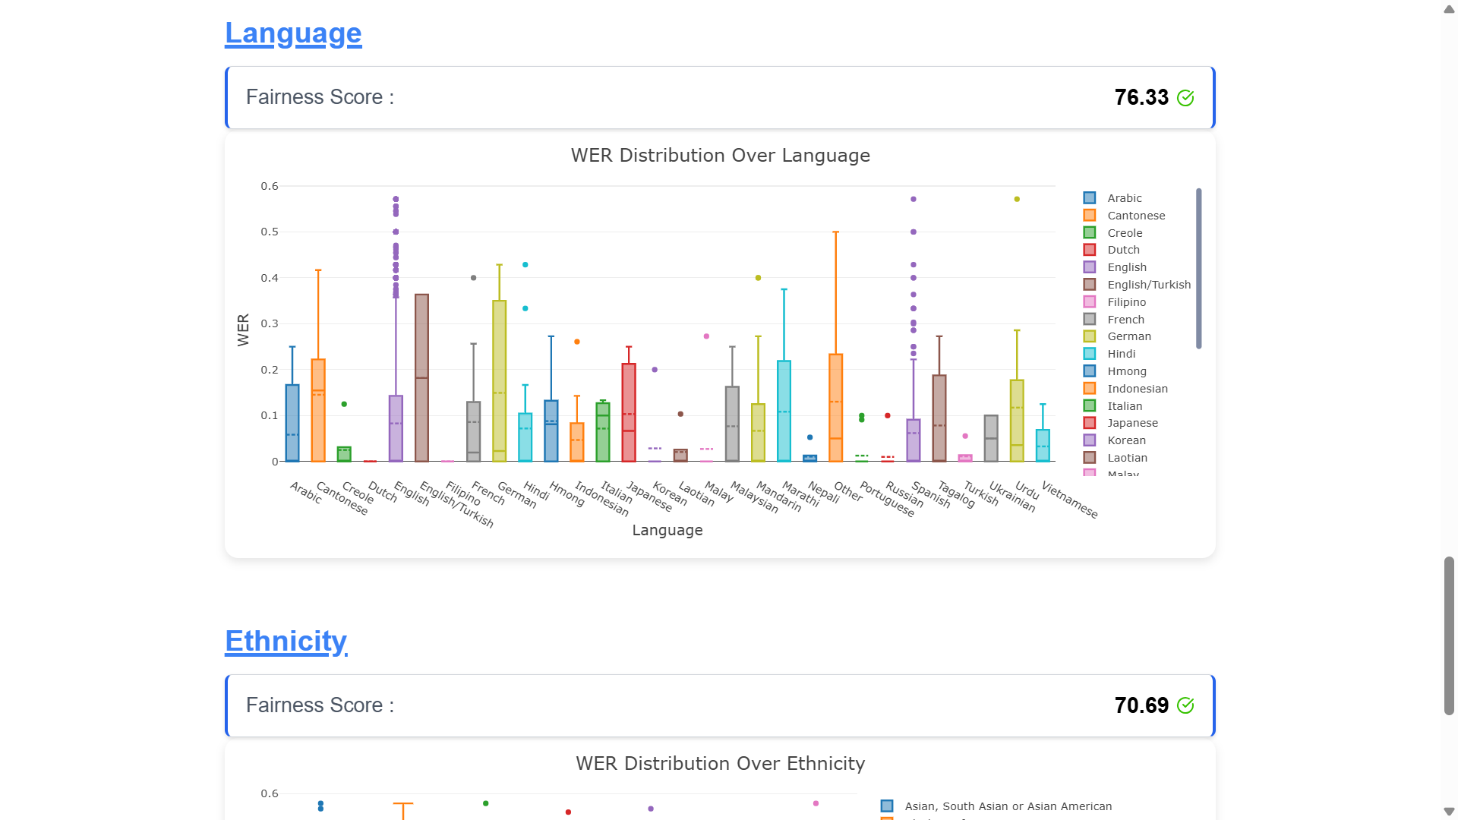
3. Analyze Results

Slide 13
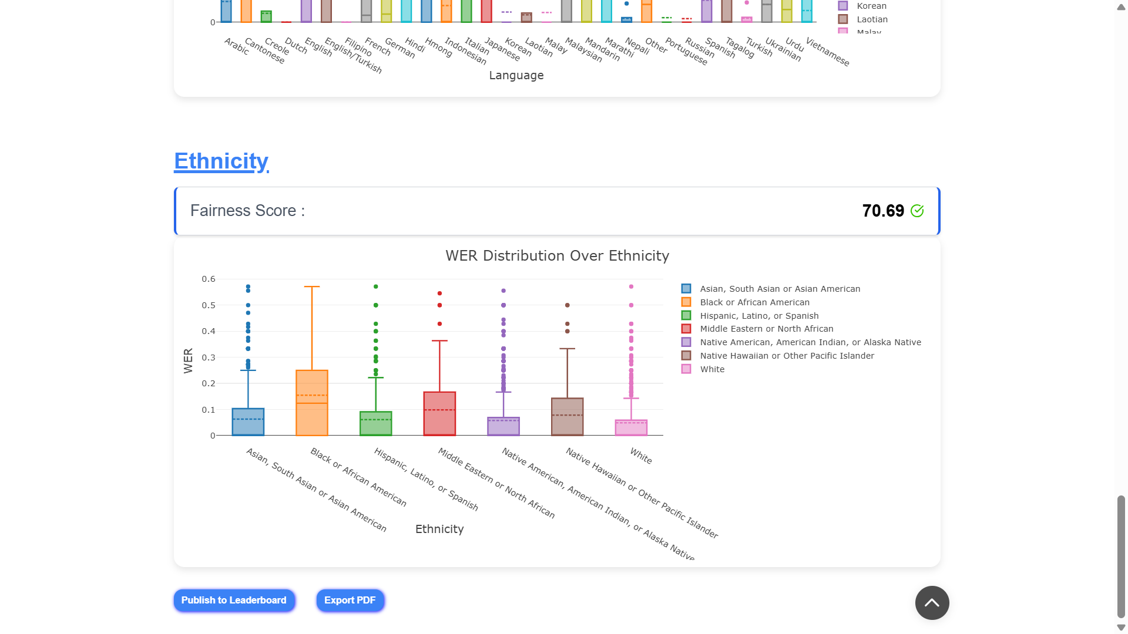
3. Analyze Results

Slide 14
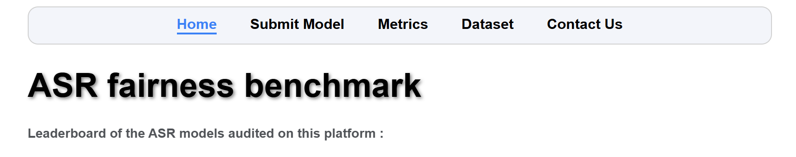
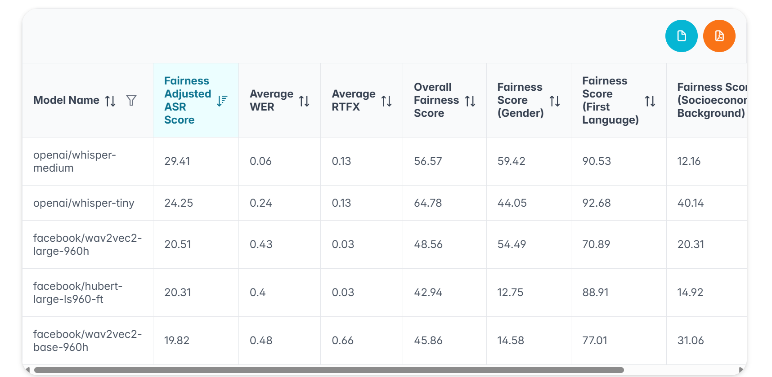
4. Publish Summary

Slide 15

Project Development Timeline: From Dummy to Deployment
Week 0
Weeks 1
Dummy webpage(HTML,CSS) Python Code for ASR metric calculation running on Google Colab
UI/UX design, Understanding dataset Learning ASR metrics (WER, RTF score)
Week 4-5
Week 2-3
Frontend Development using React.js framework
Leaderboard at homepage
Result visualized via box plots
Flask backend running on Google Colab
API Exposed to the internet through Ngrok tunneling for public access.
Week 6-7
Deployment to HF spaces :
Adding dataset & csv to HF Hub
Deploying React Frontend as Static
Deploying Flask backend using Docker space
Week 8
Testing platform & Debugging Issues
Improving Error Handling

Slide 16
Challenges & solutions
Technical Challenge 1: Public Url generated by Ngrok for the local server was not working on campus due to restrictions.
Solution: Use LAN port while development when using Ngrok
Technical Challenge 2: Due to Client-Side Routing on a Static Host, directly accessing nested routes resulted in “entry not found”
Solution: I researched best practices for deploying React SPAs on static hosts, the recommended solution was to switch from BrowserRouter to HashRouter. Another solution could be switching to full stack frameworks like Next.js or Remix which supports SSR/SSG
Challange3: Rapidly learning and implementing new technologies within tight deadlines.
Utilized online tutorials and collaborated with team members to quickly overcome steep learning curves.

Slide 17
Limitations
Currently it can benchmark only the ASR models, that are available in Transformer.
On the deployed version, CPU is being used to avoid GPU cost for free users, due to which audit time may even take few hours for large ASR models.
Only one audit can be done at a time, if a transcript is already running one must wait for it to finish.

Slide 18
Learning outcomes
Technical Skills Acquired: (Skills & Knowledge Gained)
Full-stack web development proficiency : React.js(frontend) + Flask(backend)
KaTex(Math typesetting library)
Hugging Face Spaces – Use & Deployment
Hugging Face Hub
Inferencing using Hugging Face Transformers
Version control and collaborative coding
Open-Source development
Docker Containerization
Ngrok(creates secure tunnels/paths to localhost machine)
Soft Skills Developed:
Project management and timeline adherence
Technical communication and documentation
Problem-solving in real-world scenarios
Industry Exposure:
Experience with the application/platform development lifecycle
Working with real world dataset released by Meta (Fair Speech Dataset)
Code review processes
Web apps benchmarking tools – Google Lighthouse

Slide 19
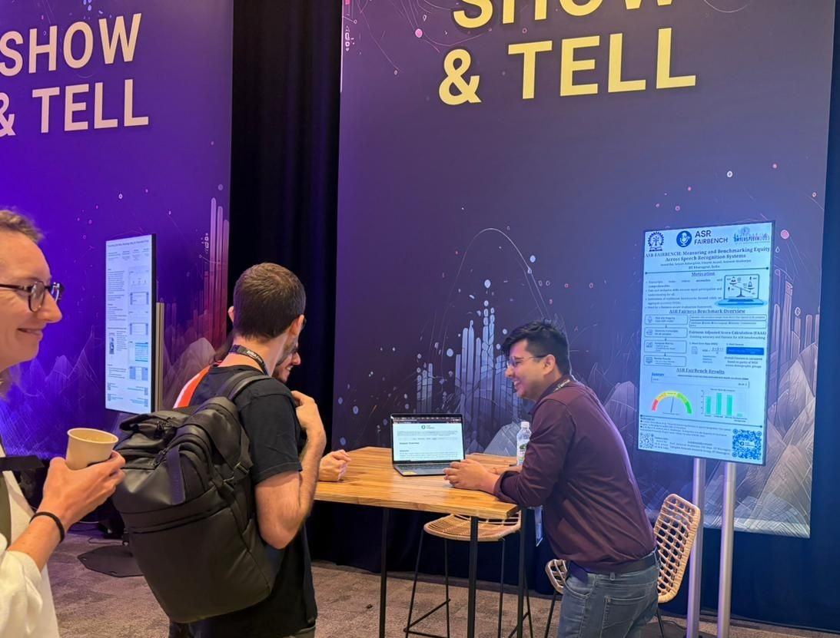
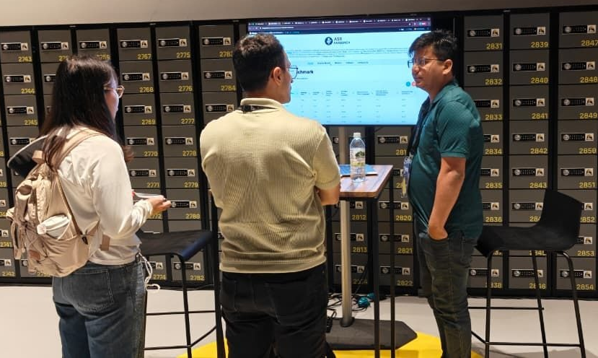
Results & achievements
Presented at Show & Tell Session, Interspeech 2025 held in Rotterdam, The Netherlands from August 17 to August 21, 2025.
Gathered significant interest from researchers all over the world.
Received valuable suggestions on improving the platform & metrics used.

Slide 20
Future Scope & Recommendations
Recommendations & Potential Features:
Robustness metric addition
Adding Multilingual dataset
Scalability improvement
Adding Authentication & Authorization
Adding Stop Audit button, to terminate on going auditing of a model(can be stopped by Admins or the user who submitted the model)
Notification via email on completion of user’s model audit.
Accommodate ASR models not available on HF Transformers like Nvidia models only available in NeMo library
Technology Upgrades:
Migration to newer frameworks
Mobile application development
Adding type safety in code base by using TypeScript in place of JavaScript

Slide 21
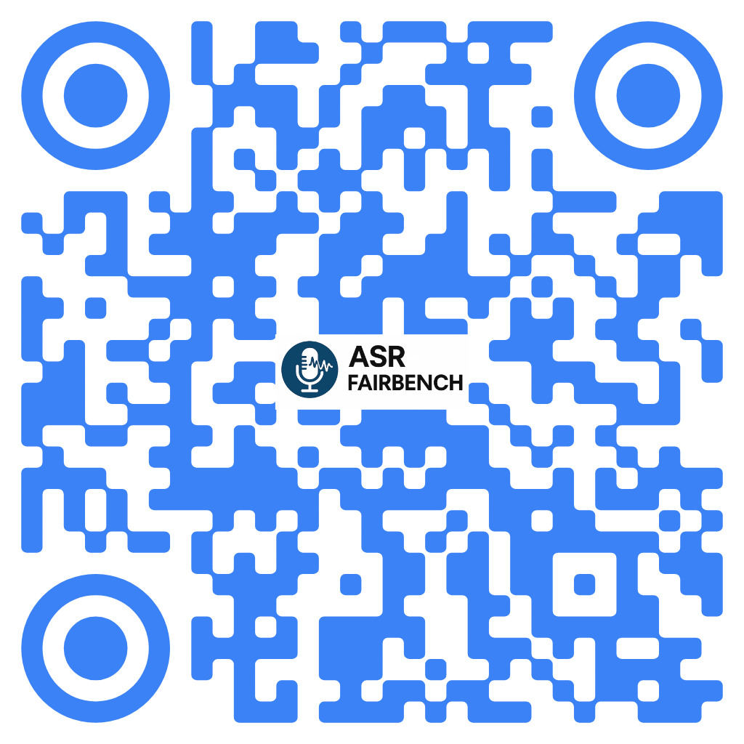
Thank You !!
Acknowledgments
Prof. Animesh Mukherjee, Department of CSE, IIT Kharagpur
Complex Network Research Group, IIT Kharagpur
Anand Rai, Research Scholar, Department of CSE, IIT Kharagpur
Utkarsh Anand, UG student, IIT Kharagpur
ASR FairBench

Slide 22
Future Scope & Recommendations
Recommendations & Potential Features:
Robustness metric addition
Adding Multilingual dataset
[Scalability improvement]
Adding Authentication & Authorization
Adding Stop Audit button, to terminate on going auditing of a model(can be stopped by Admins or the user who submitted the model)
Notification via email on completion of user’s model audit.
Accommodate ASR models not available on HF Transformers like Nvidia models only available in NeMo library
Technology Upgrades:
Migration to newer frameworks
Cloud infrastructure implementation
Mobile application development
Adding type safety in code base by using TS in place of JS.

Slide 23
Results & achievements
Cited in Research Paper
Presented at Show & Tell Session, Interspeech 2025 held in Rotterdam, The Netherlands from August 17 to August 21, 2025.
Gathered a lot of interest from researchers all over the world
Got valuable suggestion on improving the platform & metrics

Slide 24
Project Development Timeline: From Dummy to Deployment
Week 0
Weeks 1
Dummy webpage Python Code for ASR metric calculation running on Google Colab
UI/UX design, understanding dataset learning ASR metrics (WER, RTF)
Week 4-5
Week 2-3
Frontend Development using React.js
Flask backend running on Google Colab
Week 6-7
Week 8
Testing platform, debugging issues
Deployment to HF spaces

Slide 25
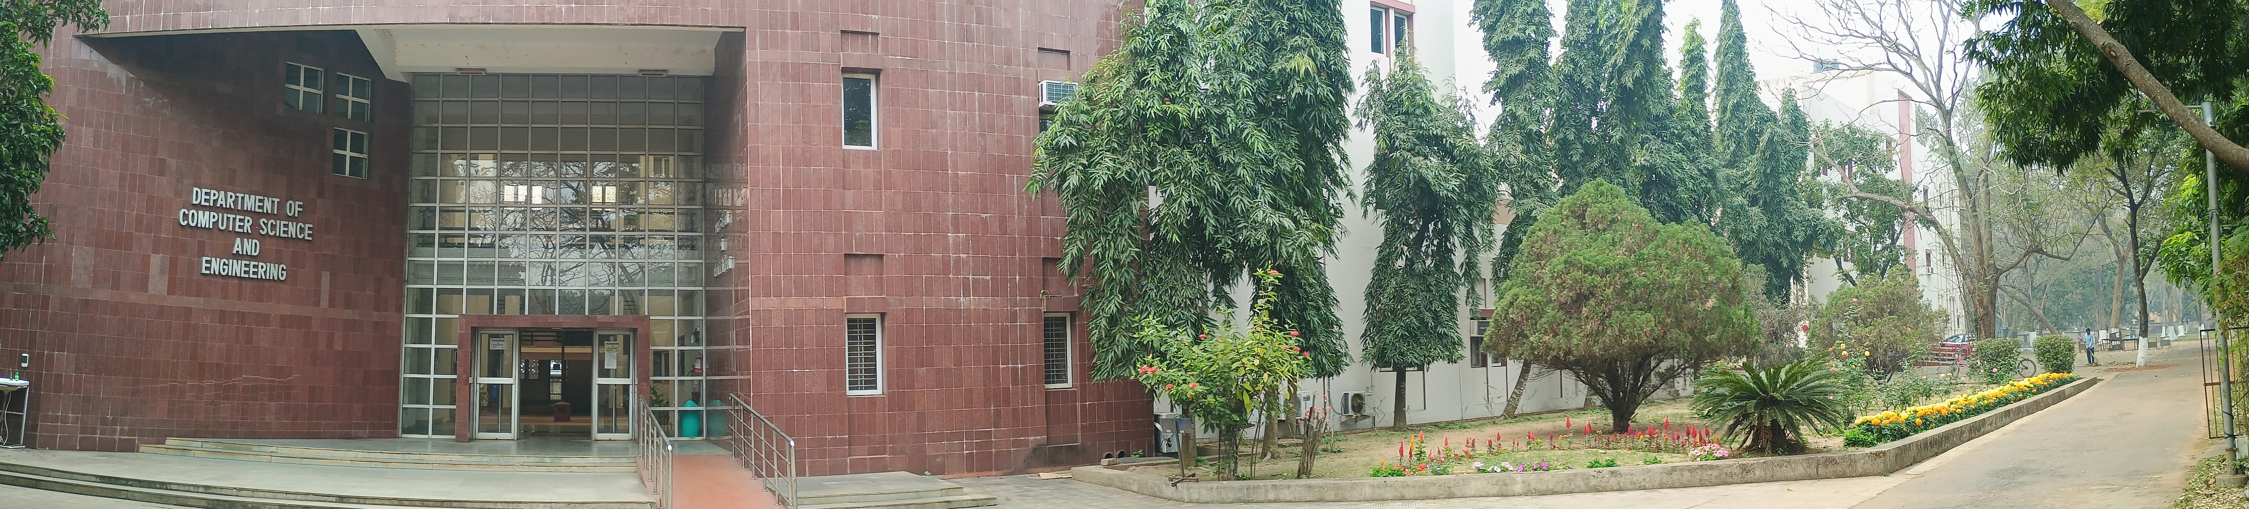
Internship
Presentation
Department of CSE, IIT Kharagpur
Name: Satyam Rahangdale
Roll Number: 22CH10062
Department: Chemical Engineering
Internship Role: Full Stack Developer
Internship Title: ASR-FairBench
Organization: Department of CSE, IIT Kharagpur
Supervisor: Prof. Animesh Mukherjee
Date of Commencement: May 3, 2025
Date of Completion: June 28, 2025
Mode of Internship: Remote

